Slide 1
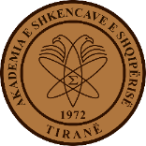
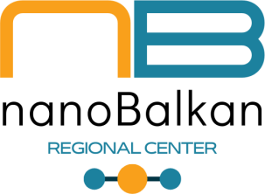
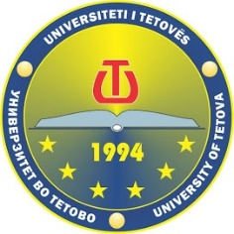
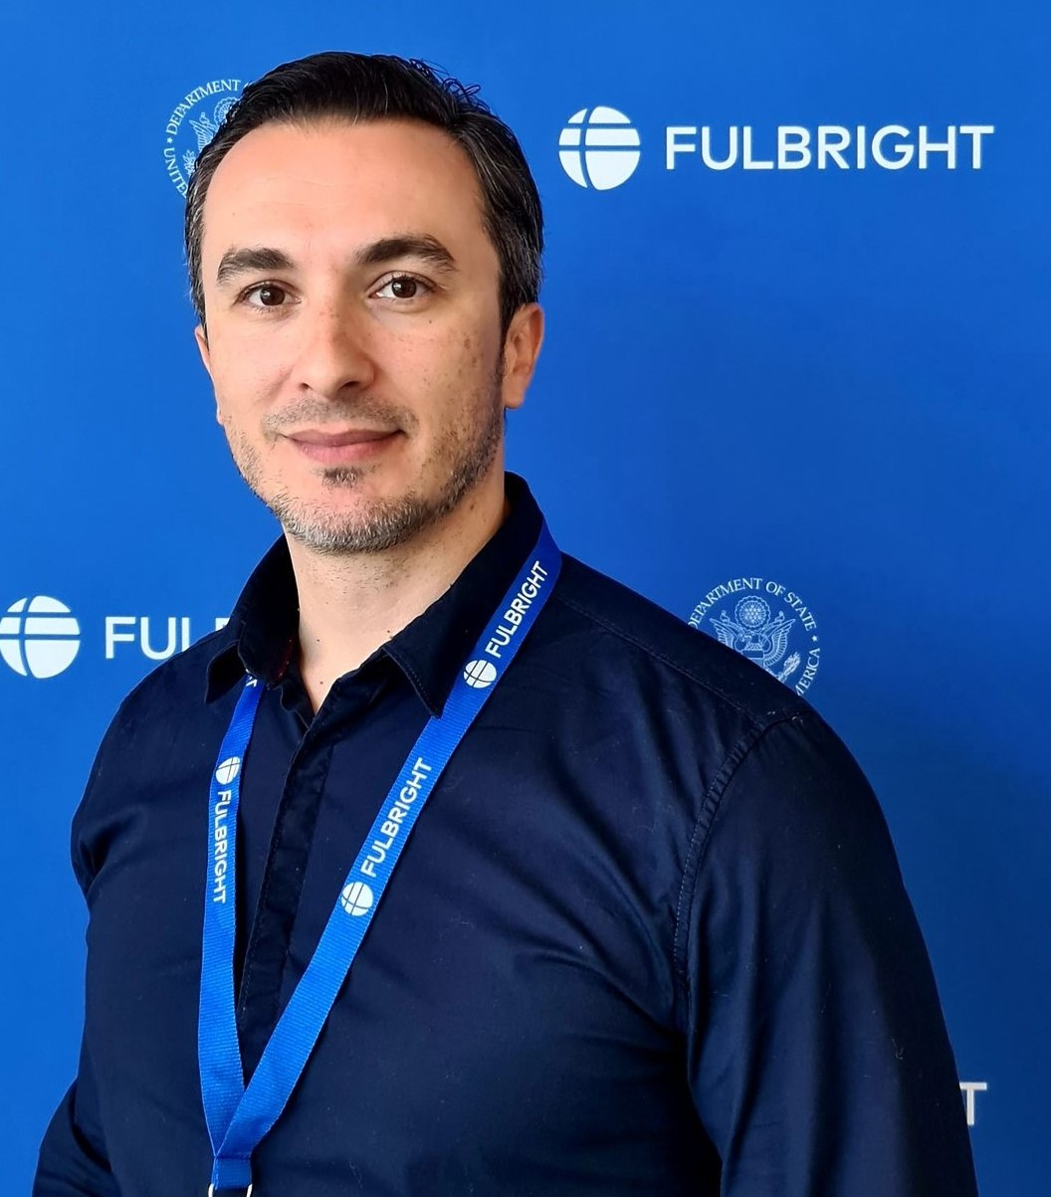
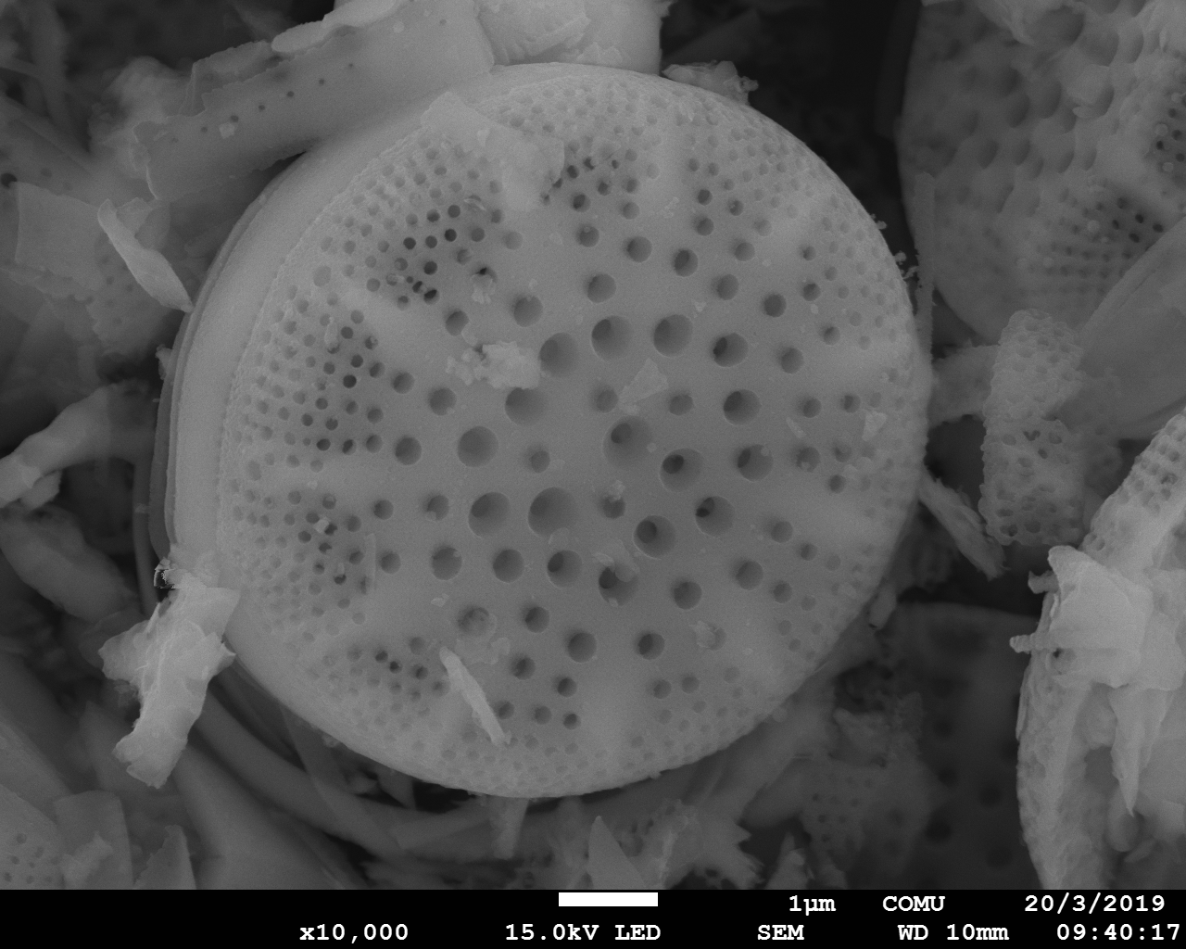
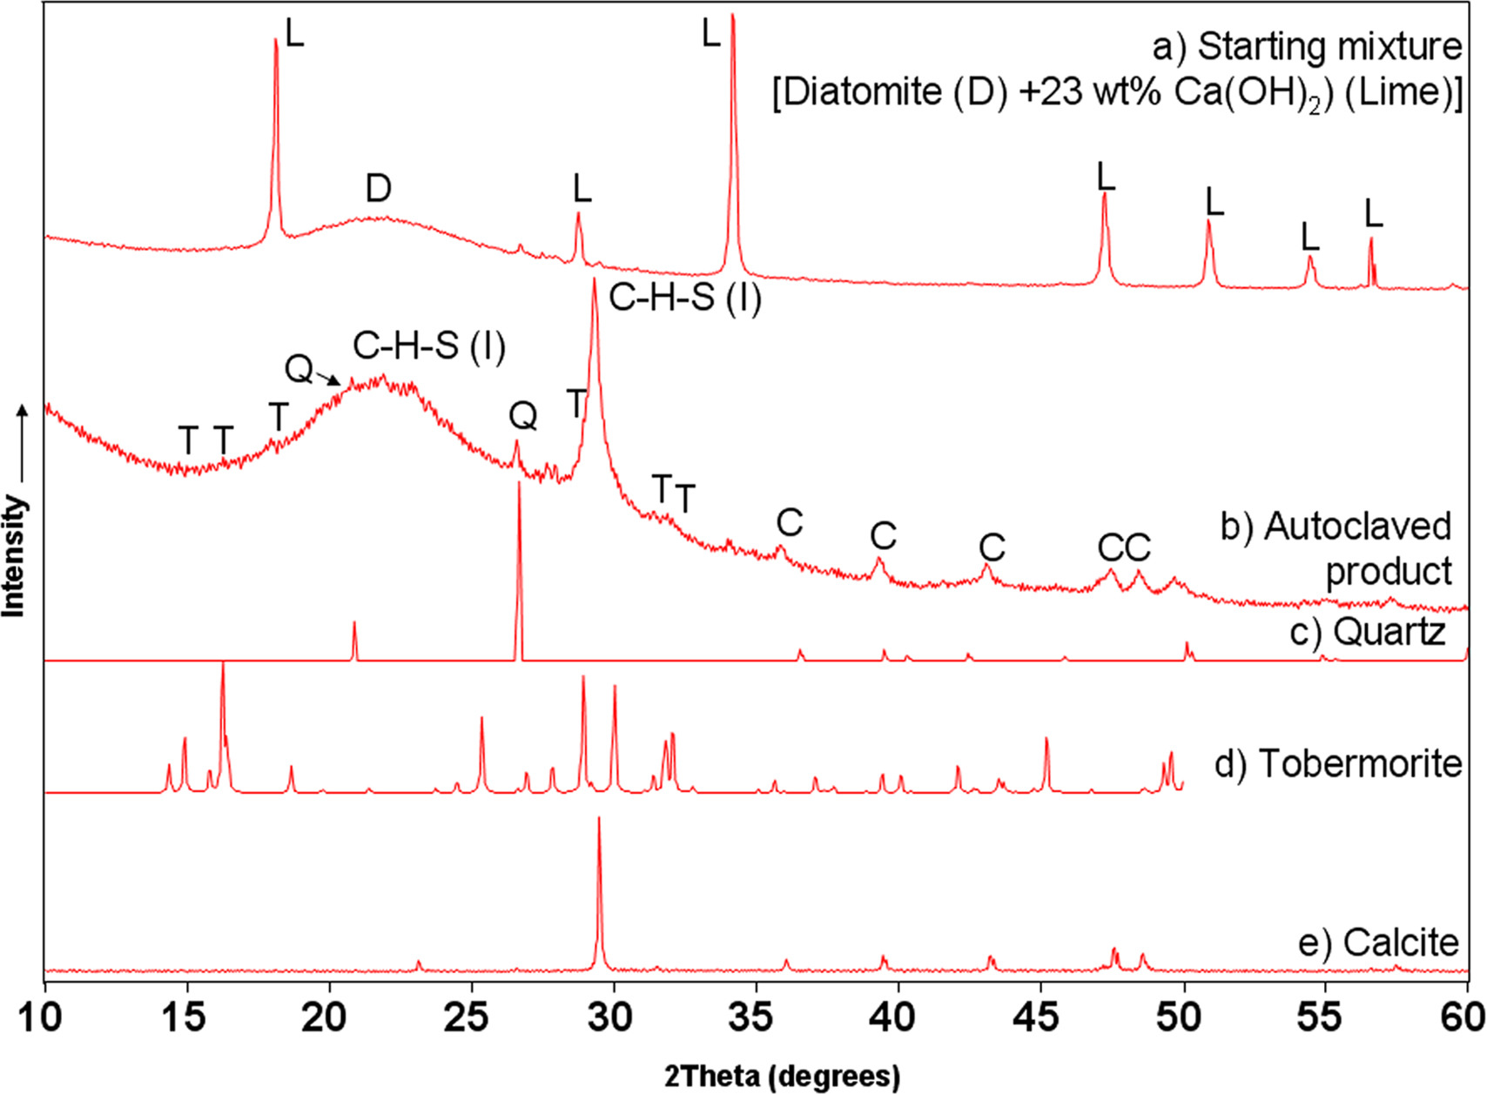
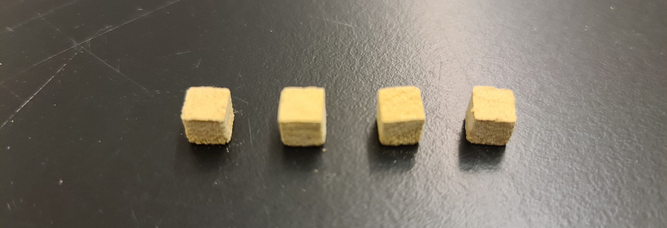
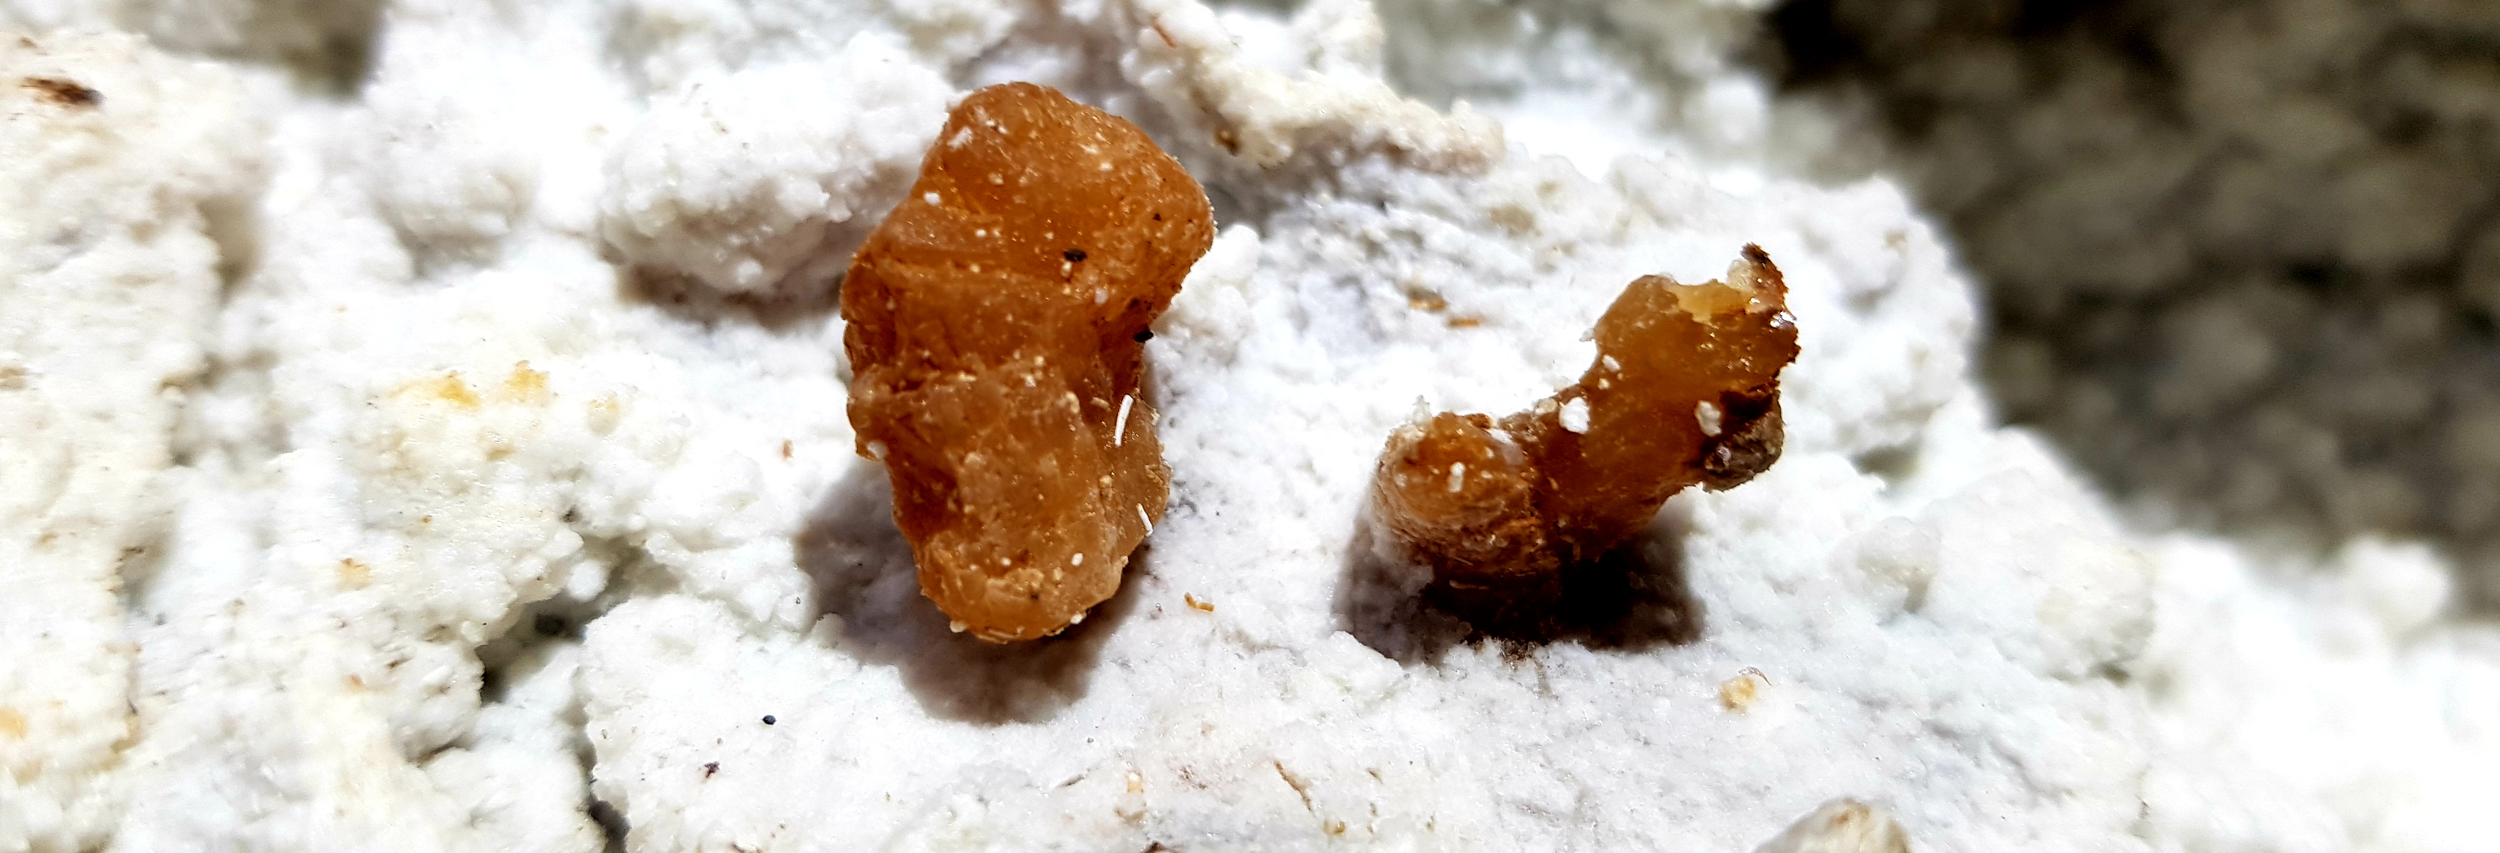
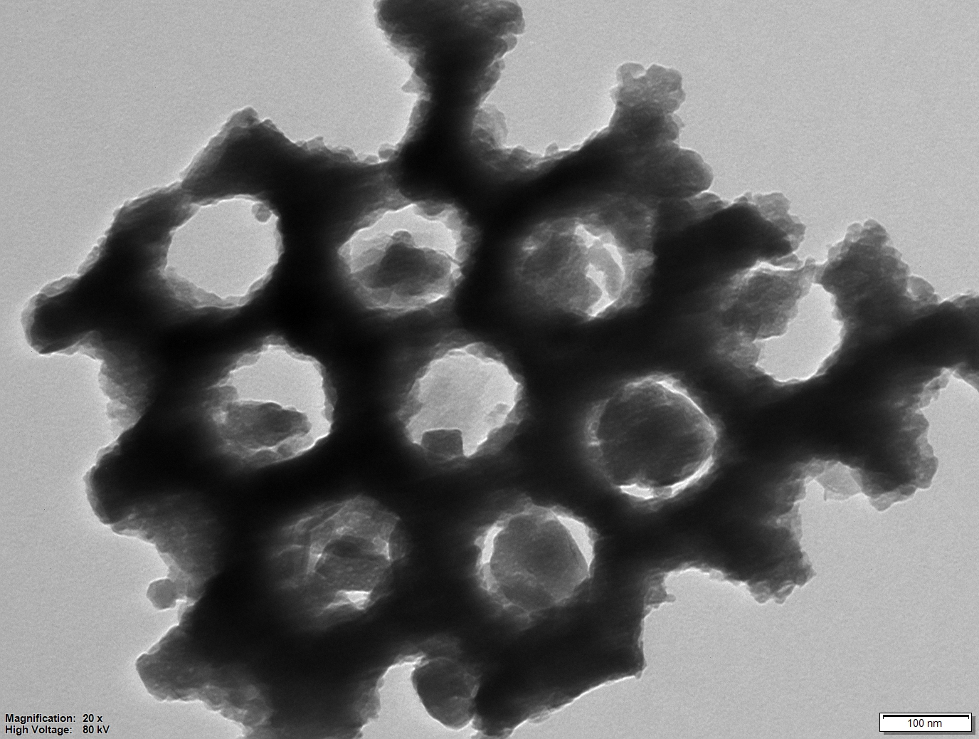
MATERIALS SYNTHESIS, CHARACTERIZATION, MODIFICATION AND
APPLICATION GROUP
Contact person/Group leader:
Dr. Arianit A. Reka, associate professor
Affiliation
Chemistry Dept., Faculty of Natural Sciences and Mathematics, University of Tetova, North Macedonia
Mail address
Blvd. Ilinden, n.n., 1200 Tetovo, North Macedonia
Email/website
arianit.reka@unite.edu.mk ; arianit.reka@gmail.com
Group Members
Dr. Arianit A. Reka, Dr. Hamdije Memedi, M.Sc.. Besarta Çeliku, M.Sc. Berat Sinani, M.Sc.. Jeta Sela, M.Sc. Kaltrina Skenderi, B.Sc. Sunaj Muslia
Google Scholar
https://scholar.google.com/citations?user=ivwm5qEAAAAJ&hl=en
Research Gate
https://www.researchgate.net/profile/Arianit_Reka
Research lines
Syntheses and characterization of ceramics materials via hydrothermal technology with the use of raw industrial minerals/wastes.
Industrial minerals characterization, modification and application.
Application of various natural inorganic sorbents for removal of pollutants from water resourcess
Industrial waste modification, application and valorization
Production of sustainable construction materials from industrial waste

